Slide 1

AMAZON SALES DATA ANALYSIS

Slide 2
INTRODUCTION
To Find insights into sales performance across various regions, product types, and sales channels.
The dataset we'll examine includes a diverse range of sales transactions from multiple continents and industries. From Europe to Oceania, and from clothing to household items, each entry captures a unique moment of commercial activity.
Our objective is clear: to analyze this data, identify significant patterns and trends, and use these insights to inform strategic decisions and drive business growth. Let's embark on our journey through Amazon's sales data and discover the stories it has to tell.

Slide 3

KPI’S
Total Revenue – The cumulative revenue generated from sales across all regions and product types.
Total Profit – The net profit earned from sales, calculated by subtracting the total cost of goods sold from the total revenue.
Region-Wise Sales – Total revenue or units sold, segmented by region, to identify the top-performing regions.
Monthly Sales Trend – Total revenue or units sold, plotted over time, to reveal seasonal trends and patterns.
Order Priority Distribution – The breakdown of orders based on their priority level (critical, high, medium, low).
Average Selling Price – The average price at which products are sold, determined by dividing the total revenue by the total number of units sold.

Slide 4
METHODOLOGY
Data Collection
The dataset was obtained from UNIFIED MENTOR. It includes various fields such as region, country, mode, price per unit, and more.
Data Cleaning
The cleaning process involved removing duplicates and null values, arranging dates in order, handling outliers, and ensuring the dataset was consistent.
Data Analysis & Visualization
We calculated summary statistics such as mean, median, standard deviation, and quartiles for numerical variables like sales revenue, units sold, and selling price. We analyzed the distribution of sales across different regions, product categories, sales channels, and order priorities.
Insights & Suggestions
Key insights were gathered that highlight significant factors influencing the sales and distribution of various items globally. Based on these insights, several suggestions were provided to the business unit to help prevent potential losses.

Slide 5
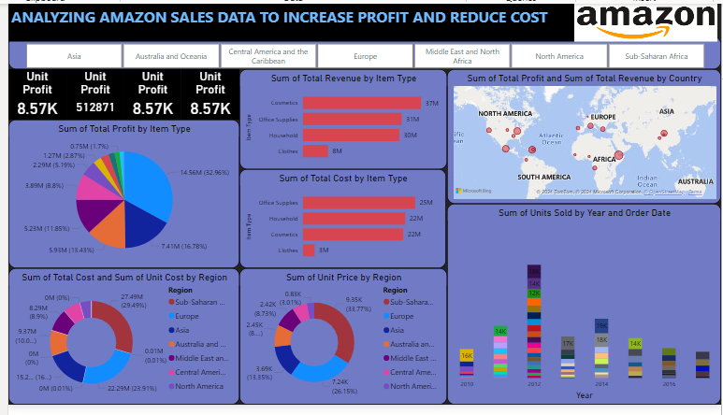
MY DESIGN

Slide 6
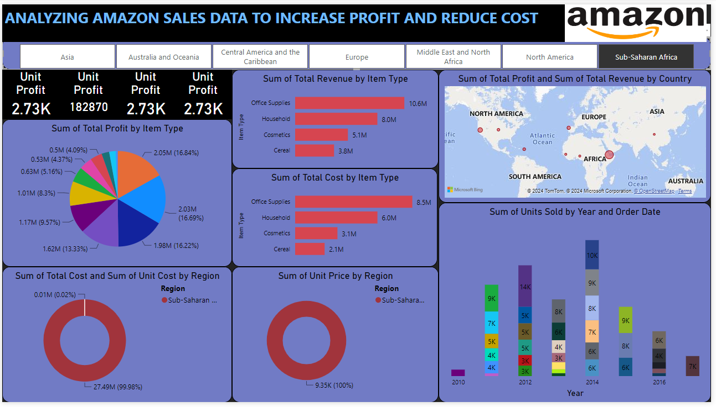
MY DESIGN

Slide 7
THANK YOU

